Slide 1
NCBI PowerScripting
Lecture 3:
Framework for Programming
April 20-22, 2005

Slide 2
Overview
Cygwin LINUX emulation environment
nedit: text editor
Module of eUtil subroutines in Perl
  NCBI_PowerScripting.pm

Slide 3
Perl Module
Programs will use NCBI_PowerScripting;
Module contains 16 subroutines:
  input: read_params
  processing: 12 eutil calling routines
  output: 3 printing routines

Slide 4
Module Header
package NCBI_PowerScripting;
use LWP::Simple;
use LWP::UserAgent;
use vars qw ($VERSION @ISA @EXPORT @EXPORT_OK);
require "ctime.pl";
use Exporter;
@ISA = qw (Exporter);
@EXPORT = qw (read_params egquery esearch esummary efetch efetch_batch elink epost_uids epost_file elink_history elink_batch elink_by_id epost_set print_summary
print_links print_link_summaries );
$VERSION = '1.4';
my $delay = 0;
my $maxdelay = 3;

Slide 5
What you will write…
command
perl myscript.pl my_input
db|nucleotide
term|mouse[orgn]
usehistory|y
my_input
#!/usr/bin/perl
use NCBI_PowerScripting;
my (%params, %results);
%params = read_params();
%results = esearch(%params);
print “Found $results{‘count’} records”;
myscript.pl

Slide 6
sub read_params
Reads an input file of parameter values and stores them in %params
db|nucleotide
term|mouse[orgn]
usehistory|y
input file
you write this!
$params{‘db’} = ‘nucleotide’
$params{‘term’} = ‘mouse[orgn]’
$params{‘usehistory’} = ‘y’
%params

Slide 7
eUtil Subroutines
%params
%results ($results)
Basic Routines
Pipeline Routines
sub egquery
sub esearch
sub esummary
sub efetch
sub elink
sub elink_history
sub epost_uids
sub efetch_batch
sub elink_batch
sub elink_by_id
sub epost_file
sub epost_set

Slide 8
esearch Input
Find all mouse RefSeq proteins
db|protein
term|mouse[orgn]+AND+srcdb+refseq[prop]
usehistory|y
$params{‘db’} = ‘protein’
$params{‘term’}= ‘mouse[orgn]+AND+srcdb+refseq[prop]’
$params{‘usehistory’} = ‘y’

Slide 9
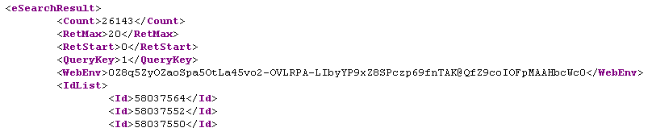
esearch Output
Find all mouse RefSeq proteins
$params{‘db’} = ‘protein’
$params{‘term’}= mouse[orgn]+AND+srcdb+refseq[prop]
$params{‘usehistory’} = ‘y’
$results{‘count’}
$results{‘query_key’}
$results{‘WebEnv’}
@{$results{‘uids’}} (an array)

Slide 10
sub esearch
local %params = @_; #get input parameters
[declare variables]
$url = $base . “esearch.fcgi?db=$params{‘db’}”;
$url .= “&term=$params{‘term’}…”;
$raw = get($url); #post URL, results into $raw
$raw =~ /<Count>(/d+)<\/Count>/s; #parse count
$results{‘count’} = $1; #(/d+) into $1
[continue parsing]
return(%results);

Slide 11
Some Perlish Tricks
Working with multidimensional arrays and hashes
$results{‘count’} = 5287
$results{‘WebEnv’} = A13dkJ_34Kdkfhj305
$results{‘query_key’} = 2
@{$results{‘uids’}} = (345,1201,930,20,595)
$results{‘uids’}[1] = 1201
foreach ( @{$results{‘uids’}} ) {
print “$_\n”;
}

Slide 12
ESummary Routines
sub esummary
Runs ESummary and parses XML output into %results
%results = esummary(%params);
sub print_summary
Prints %results in a human-readable format
print_summary(%results);

Slide 13
sub esummary
Download the resolutions of structures corresponding to a list of MMDB-IDs
ESummary is particularly useful for databases NOT supported by EFetch!
db|structure
id|6492,10919
$params{‘db’} = ‘structure’
$params{‘id’} = ‘6492,10919’
$params{‘db’} = ‘structure’
$params{‘id’} = ‘6492,10919’
$results{‘uid’}{‘item name’}

Slide 14
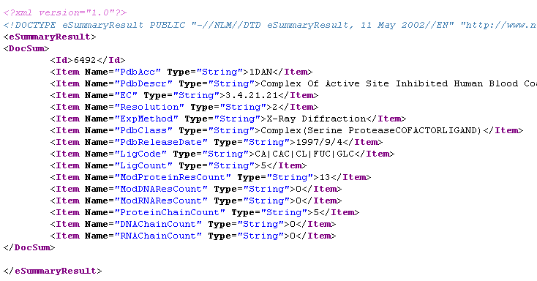
esummary Output
Download the resolutions of structures corresponding to a list of MMDB-IDs
$results{‘6492’}{‘Resolution’} = ‘2’

Slide 15
print_summary
print_summary(%results);
Writes to standard output, not a file
ID 6492:
DNAChainCount: 0
EC: 3.4.21.21
ExpMethod: X-Ray Diffraction
LigCode: CA|CAC|CL|FUC|GLC
LigCount: 5
ModDNAResCount: 0
ModProteinResCount: 13
ModRNAResCount: 0
PdbAcc: 1DAN
PdbClass: Complex(Serine ProteaseCOFACTORLIGAND)
PdbDescr: Complex Of Active Site Inhibited Human Blood Coagulation Factor Viia With Human Recombinant Soluble Tissue Factor
PdbReleaseDate: 1997/9/4
ProteinChainCount: 5
RNAChainCount: 0
Resolution: 2

Slide 16
EFetch Routines
sub efetch
Posts only 1 EFetch URL
Designed for small datasets (< 500 records)
Input UIDs assigned to &id as a comma-delimited list
Output passed to a string
$output = efetch(%params);
sub efetch_batch
use after ESearch, EPost, or ELink
Posts a series of EFetch URLs
Designed for large datasets (> 500 records)
Input UIDs must be on the History server
Output written to a file name $params{‘outfile’}
efetch_batch(%params);

Slide 17
sub efetch
Download the CDS (85-2886) of nucleotide GI 4680720 in FASTA format
db|nucleotide
id|4680720
retmode|text
rettype|fasta
seq_start|85
seq_stop|2886
$params{‘db’} = ‘nucleotide’
$params{‘id’} = 4680720
$params{‘retmode’} = ‘text’
$params{‘rettype’} = ‘fasta’
$params{‘seq_start’} = 85
$params{‘seq_stop’} = 2886

Slide 18
EFetch Output
Download the CDS (85-2886) of nucleotide GI 4680720 in FASTA format
>gi|4680720|gb|M17755.2|HUMTPOC Homo sapiens thyroid peroxidase (TPO) mRNA, complete cds
GAGGCAATTGAGGCGCCCATTTCAGAAGAGTTACAGCCGTGAAAATTACTCAGCAGTGCAGTTGGCTGAG
AAGAGGAAAAAAGAATGAGAGCGCTGGCTGTGCTGTCTGTCACGCTGGTTATGGCCTGCACAGAAGCCTT
CTTCCCCTTCATCTCGAGAGGGAAAGAACTCCTTTGGGGAAAGCCTGAGGAGTCTCGTGTCTCTAGCGTC
TTGGAGGAAAGCAAGCGCCTGGTGGACACCGCCATGTACGCCACGATGCAGAGAAACCTCAAGAAAAGAG
GAATCCTTTCTGGAGCTCAGCTTCTGTCTTTTTCCAAACTTCCTGAGCCAACAAGCGGAGTGATTGCCCG
AGCAGCAGAGATAATGGAAACATCAATACAAGCGATGAAAAGAAAAGTCAACCTGAAAACTCAACAATCA
CAGCATCCAACGGATGCTTTATCAGAAGATCTGCTGAGCATCATTGCAAACATGTCTGGATGTCTCCCTT
ACATGCTGCCCCCAAAATGCCCAAACACTTGCCTGGCGAACAAATACAGGCCCATCACAGGAGCTTGCAA
CAACAGAGACCACCCCAGATGGGGCGCCTCCAACACGGCCCTGGCACGATGGCTCCCTCCAGTCTATGAG
GACGGCTTCAGTCAGCCCCGAGGCTGGAACCCCGGCTTCTTGTACAACGGGTTCCCACTGCCCCCGGTCC
GGGAGGTGACAAGACATGTCATTCAAGTTTCAAATGAGGTTGTCACAGATGATGACCGCTATTCTGACCT
CCTGATGGCATGGGGACAATACATCGACCACGACATCGCGTTCACACCACAGAGCACCAGCAAAGCTGCC
TTCGGGGGAGGGTCTGACTGCCAGATGACTTGTGAGAACCAAAACCCATGTTTTCCCATACAACTCCCGG
AGGAGGCCCGGCCGGCCGCGGGCACCGCCTGTCTGCCCTTCTACCGCTCTTCGGCCGCCTGCGGCACCGG
$params{‘db’} = ‘nucleotide’
$params{‘id’} = 4680720
$params{‘retmode’} = ‘text’
$params{‘rettype’} = ‘fasta’
$params{‘seq_start’} = 85
$params{‘seq_stop’} = 2886
$results

Slide 19
EPost Routines
sub epost_uids
Runs EPost with GET method
&id is a comma-delimited list
use for small sets of UIDs (< 250)
%results = epost_uids(%params);
sub epost_set
Runs EPost with POST method
&id is a comma-delimited list
use for large sets of UIDs (> 250)
%results = epost_set(%params);
sub epost_file
Runs EPost with POST method
&id is a file name containing one UID per line
use for large sets of UIDs (> 250)
%results = epost_file(%params);

Slide 20
sub epost_uids
Upload a list of 35 PMIDs
db|pubmed
id|15075265,15068336,15007097,15003443…
$params{‘db’} = ‘pubmed’
$params{‘id’} = ‘15075265,15068336,15007097,15003443…’
$results{‘query_key’}
$results{‘WebEnv’}

Slide 21

POSTing a URL
NCBI
$response = $ua->request($req)
HTTP
Request
User Agent
HTTP
Response
$ua = LWP::UserAgent->new
$req = new HTTP::Request POST
For Perl, you need libwww-perl-5.800

Slide 22
sub epost_set
Upload a list of 35,000 PMIDs
db|pubmed
id|15075265,15068336,15007097,15003443…
$params{‘db’} = ‘pubmed’
$params{‘id’} = ‘15075265,15068336,15007097,15003443…’
$results{‘query_key’}
$results{‘WebEnv’}

Slide 23
sub epost_file
Upload a file of 1200 Gene IDs
db|gene
id|gene_ids.inp
$params{‘db’} = ‘gene’
$params{‘id’} = ‘gene_ids.inp’
The input filename is assigned to &id
$params{‘db’} = ‘gene’
$params{‘id’} = ‘gene_ids.inp’
$results{‘query_key’}
$results{‘WebEnv’}

Slide 24
ELink Routines
sub elink_batch
Finds one set of links for the entire set of input UIDs
%results = elink_batch(%params);
sub elink_by_id
Finds separate sets of links for each input UID
%results = elink_by_id(%params);

Slide 25
elink_batch
Find homologous genes for GeneID 7173,7067 and 3565
The input filename must contain &dbfrom!
dbfrom|gene
db|homologene
id|7173,7067,3565
$params{‘dbfrom’} = ‘gene’
$params{‘db’} = ‘homologene’
$params{‘id’} = 7173,7067,3565
$results{‘query_key’} = query key for linked UIDs
$results{‘WebEnv’} = WebEnv for linked UIDs

Slide 26
elink_by_id
Find homologous genes for GeneID 7173,7067 and 3565
The input filename must contain &dbfrom!
dbfrom|gene
db|homologene
id|7173,7067,3565
$params{‘dbfrom’} = ‘gene’
$params{‘db’} = ‘homologene’
$params{‘id’} = 7173,7067,3565
$results{id}{‘query_key’} = query key for UIDs linked to id
$results{id}{‘WebEnv’} = WebEnv for UIDs linked to id

Slide 27
Manipulating UID Lists
WebEnv
query_key
EPost
ESearch
split(/,/,$list)
comma-delimited list
array
join(‘,’,@array)

Slide 28
Retrieving a UID List from History
Run ESearch twice: first to get the size of the list;
second to retrieve the UIDs
%params1 = read_params();
%results1 = esearch(%params1);
$params1{‘retmax’} = $results1{‘count’};
%results1 = esearch(%params1);
@uid_list = @{$results1{‘uids’}};

